Slide 1



Predicting the Impact of Parameter Adjustments on Cellular Networks
Yongqian Sun¹, Qingliang Zhang¹, Yu Luo¹, Mingjie Li^{2*}, Shenglin Zhang¹,
Xiaolei Hua², Renkai Yu², Xinwen Fan², Lin Zhu², Junlan Feng², Dan Pei³
¹Nankai University ²China Mobile Research Institute ³Tsinghua University
Notes:
Hello, everyone, I am Cui Tianyu from Nankai University
Today I will introduce our work: "Predicting the Impact of Parameter Adjustments on Cellular Networks”.
This is a collaborative work of Nanaki University, China Mobile Research Institute and Tsinghua University.

Slide 2





Content
Background
Challenges
Approach
Evaluation
Conclusion
Notes:
First, I will introduce backgound.

Slide 3




Ensuring 5G Service Quality for Better User Experience
Internet
Service
Adjust
Impact
User Equipment
Operators
Parameters of gNB
Next-Generation
NodeB
（gNB）
Internet
Service
User Equipment
Cellular networks are the backbone of internet access
The gNBs provide connectivity to user equipments
Operators typically adjust gNB parameters to optimize network performance
Network stability and service quality are essential
Notes:
With the continuous rollout of 5G, cellular networks have become the core infrastructure for internet access.
They are widely deployed in Next-Generation NodeBs, or gNBs, to provide connectivity for user devices.
To optimize network performance, operators adjust key gNB parameters to influence network conditions.
As user distribution and traffic demand fluctuate across time and locations, ensuring network stability and service quality is crucial for delivering a great user experience.

Slide 4
Key Parameters and Cell Status Metrics
Key Parameters:
Transmission Power (TP): TP controls the received signal strength
Cell Individual Offset (CIO): CIO controls handovers and achieve proper load balancing
Key Cell Status Metrics:
Workload: The number and behaviors of served UEs
Quality of Service(Qos) : Quality of Service measurements
Interference : The strength of irrelevant electromagnetic waves
Notes:
When optimizing network performance, operators mainly adjust two key parameters: Transmission Power, or TP, and Cell Individual Offset, or CIO.
Transmission power is a fundamental parameter of a cell — the higher the transmission power, the higher the received signal strength.
CIO is a parameter introduced by 3GPP to control handovers and achieve proper load balancing.
Interference, measured as noise level, is beyond the control of a gNB but can still negatively affect QoS.
Among these metrics, Workload and Quality of Service, or QoS, are the most important for overall performance.

Slide 5


Adjusting GNB Parameters to Optimize Performance
Adjust
parameter
Imprecise & Repeated Adjustments
Degraded
Service
Operators
Delayed
status feedback
High-Quality
Service
Precise & efficient adjustments
gNB
Correct gNB parameter adjustments are vital for user experience
Status feedback can be delayed by hours
Imprecise adjustments slow optimization and harm user experience
Notes:
When adjusting gNB parameters, making correct adjustment decisions is crucial for user experience.
Operators typically do not manage gNBs directly, so feedback on the network state after adjustments can be delayed by hours.
As a result, imprecise adjustments may require multiple attempts to take effect, increasing optimization time and negatively impacting user experience.

Slide 6
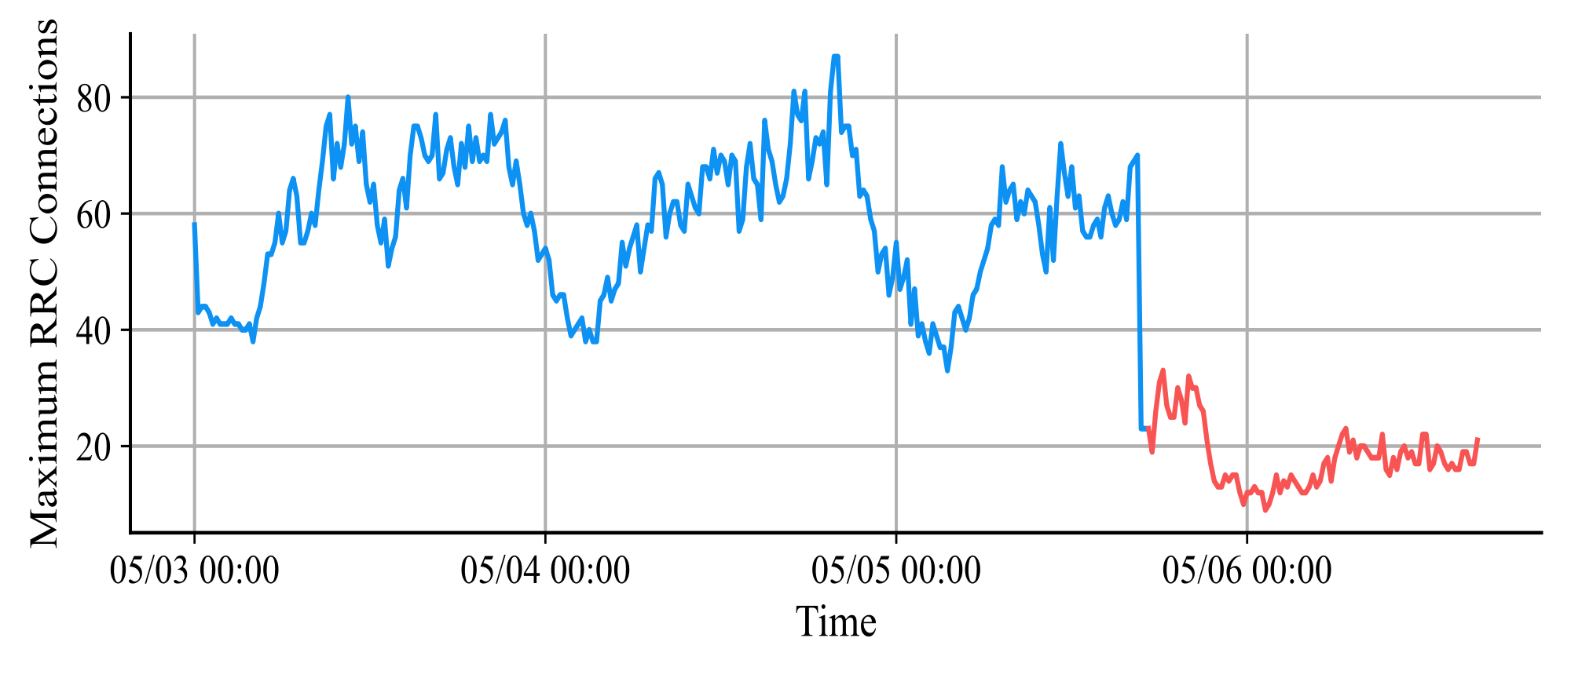
Problem Statement
TP=18.2dBm TP=12.2dBm
Example of a cell parameter adjustment
Existing traffic prediction and time-series forecasting methods:
assume static configurations and fail with sudden parameter changes
Concept drift methods:
adapt after changes but cannot anticipate their impact
Our goal is to develop a method that can
model the effects of parameter adjustments before they are applied, enabling proactive and accurate network performance predictions
Notes:
Here’s an example of a cell parameter adjustment.
The cell’s maximum number of Radio Resource Control connections—which reflects Workload—drops sharply after the transmission power is reduced by 6 dBm.
The dashed vertical line marks the first data point under the new power setting.
Our goal is to accurately predict these metric changes after parameter adjustments, that is, the part of the curve to the right of the line.
Existing traffic prediction and time-series forecasting methods can capture general network trends, but they assume static configurations.
Sudden parameter changes can cause abrupt shifts in metrics, making standard forecasts unreliable.
Concept drift methods can adapt, but only after the change happens—they can’t anticipate the impact.

Slide 7


Content
Background
Challenges
Approach
Evaluation
Conclusion
Notes:
However, we face several challenges in designing this method.

Slide 8
Limited Data for Parameter Adjustments
Challenge 1: Limited data for parameter adjustments
Limited historical data hinders learning generalizable impact patterns
Even TP and CIO yield over 18,000 combinations, far beyond available data
This vast space far exceeds availabledata coverage
Challenge 2: Complex, dynamic dependencies among multiple metrics
Modeling metric dependencies under cell parameter adjustments is challenging
17 key metrics from China Mobile, grouped into 3 clusters
Dependencies are dynamic, nonlinear, and context-sensitive
Notes:
Designing a predictive framework for cell parameter adjustments comes with two main challenges.
First, the data for parameter adjustments is very limited.
Historical data on parameter changes is limited, which makes it difficult to learn generalizable patterns for impact prediction.
Even when considering only two common parameters — Transmission Power ranging from zero to sixty decibels and CIO with thirty-one options from minus twenty-four to twenty-four decibels
— there are already more than eighteen thousand possible combinations.
This enormous space goes far beyond the available data coverage, not to mention that each 5G site has over two thousand tunable parameters.
Second, the dependencies among multiple performance metrics are complex.
In real networks, these relationships are dynamic, nonlinear, and context-dependent.
Our dataset covering seventeen key performance metrics grouped into three clusters.
Capturing the joint behavior of all metrics under changing parameters is particularly challenging.
Together, these two issues define the core difficulties we need to address in building an effective prediction framework.

Slide 9
PIPCell
PIPCell
🚀
Predictive framework
that models the effect of cell parameter adjustments
on key metrics
Notes:
To tackle the aforementioned challenges, we propose PIPCell, a predictive framework that models the effect of cell parameter adjustments on key cell metrics.
To the best of our knowledge, we are the first to propose a predictive framework that models the impact of cell parameter adjustments on cellular network time series.
PIPCell enables proactive network optimization by forecasting how changes to TP and CIO influence key metrics.

Slide 10

Content
Background
Challenges
Approach
Evaluation
Conclusion
Notes:
Next, I will introduce the design of PIPCell in detail.

Slide 11






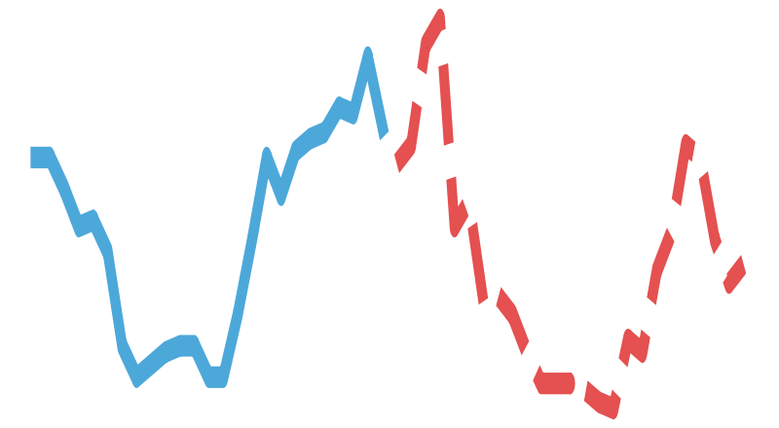
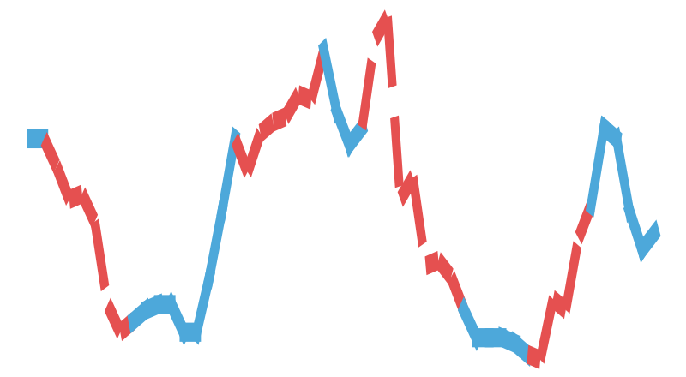


Overview
Pretraining
Predicting
Adjusting
HC-PEP
Adjustment-Free Data
TP & CIO Changes
&
Workload’s
Transformer
Workload Prediction
Transformer
Workload History
Interference’s
Transformer
Interference History
Interference Prediction
Prediction Task
Propagating
Reconstruction Task
QoS’s
Transformer
QoS Prediction
Pretrained
Transformer
QoS History
Notes:
To address these challenges, we introduce PIPCell, a framework designed to model how changes in network parameters impact multiple performance metrics.
We start by pretraining PIPCell on data without any parameter adjustments. This allows the model to learn basic time-series patterns and provides a strong foundation for prediction, even when data on parameter changes is limited.
During inference, PIPCell operates in two stages.
In the first stage, it predicts Workload and Interference, and then refines the Workload prediction using the Homogeneous Cell Parameter Effect Predictor, or HC-PEP.
In the second stage, it leverages Graphical Transformers organized according to a dependency graph.
This design enables parameter effects to propagate across metrics, capturing complex interdependencies in a controlled and interpretable way.

Slide 12
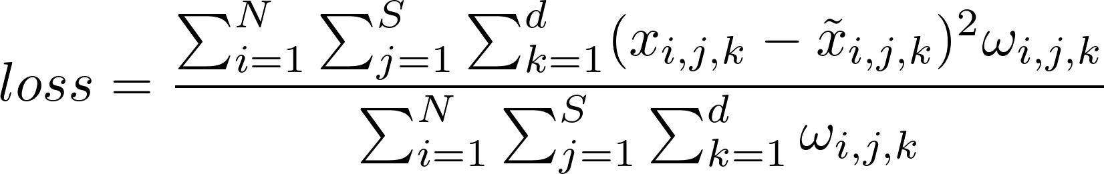


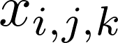
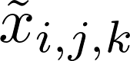
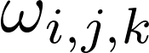
Pretraining
Pretraining
Transformer Pretraining:
Handles long-range dependencies in multivariate time series
Pretrained per metric cluster on adjustment-free data
Trained with two tasks: forecasting and masked reconstruction
Loss: average squared error, ignoring missing data
Adjustment-Free Data
&
Transformer
N: number of samples
S: sequence length
d: number of metrics
Prediction Task
– true value (sample i, timestep j, metric k)
Reconstruction Task
– predicted or reconstructed value
– availability mask (1 if valid, 0 if missing)
Pretrained
Transformer
Notes:
Now let’s look at the prediction backbone inside PIPCell. We use Transformers as our main prediction engine because they handle long-range dependencies and complex patterns in multivariate time series very well.
Each Transformer focuses on a cluster of related metrics and is pretrained on adjustment-free data to learn basic trends.
To make the model generalize better, we train it with two complementary tasks.
One is forecasting, where the model predicts future values from past observations.
The other is masked reconstruction, inspired by masked autoencoders, where we randomly hide parts of the input sequence and ask the model to recover them.
The loss function is simply the average squared difference between the predicted values and the true values, summed over both tasks.
In other words, the model learns to both predict the future and fill in missing parts of the past, giving it a more robust understanding of the data.

Slide 13






Homogeneous Cell Modeling
Strongest RSRP+CIO
Workload before and after adjustment
cell_t
cell_s_2
cell_s_1
After
adjustment
Before
adjustment
(under uniform user density assumption)
Transmission power (TP) directly affects the received signal strength(RSRP)
Cell Individual Offset (CIO) is used for load balancing
A User equipment chooses serving cell with strongest weighted signal
Assume uniform user density across the cell
TP and CIO adjustments change the cell coverage area
Workload change is estimated by the area ratio before and after adjustment
Notes:
Now that we’ve seen how the model learns from historical data, lets focus on what its actually predicting — specifically, how changes in cell parameters impact network workload.
In our model, each gNB has multiple antennas, with each antenna covering one cell.
The main parameters we control are Transmission Power or TP and Cell Individual Offset, or CIO.
Transmission power directly affects the received signal strength
Cell Individual Offset is used for load balancing.
A User equipment chooses its serving cell based on a weighted signal
Because we don’t have detailed user trajectory data, we assume that the average user density near the cell boundary is similar to that of the entire cell.
Using this assumption, we can approximate the workload change caused by parameter adjustments with the area ratio — essentially comparing the cell area before and after the adjustment.
This gives us a direct way to capture how physical parameter changes translate into workload variations.
We define the area ratio function, which tells us how the cell area changes under specific parameter adjustments.
This function provides a direct way to link TP and CIO changes to workload variations.

Slide 14

Adjusting
Adjusting
HC-PEP
TP & CIO Changes
Workload’s
Transformer
Workload Prediction
Workload History
Interference’s
Transformer
Interference History
Interference Prediction
Transformer predicts workload and interference without parameter adjustments
Homogeneous Cell Parameter Effect Predictor (HC-PEP) ：
I ntegrates physical parameter effects (TP&CIO) into workload prediction
Acts as a multiplier on Transformer outputs
Adjusts workload based on area ratio derived from parameter changes
Eliminates the need for additional adjustment data
Notes:
Once we’ve calculated how the cell area changes with TP and CIO adjustments, we feed this information into the Homogeneous Cell Parameter Effect Predictor module.
Think of HC-PEP as a multiplier: after the Transformer predicts the workload and interference assuming no parameter changes,
HC-PEP scales the workload prediction according to the new transmission power and cell offset.
In this way, we directly capture the effect of parameter adjustments on workload — all without needing any additional adjustment-specific data.

Slide 15

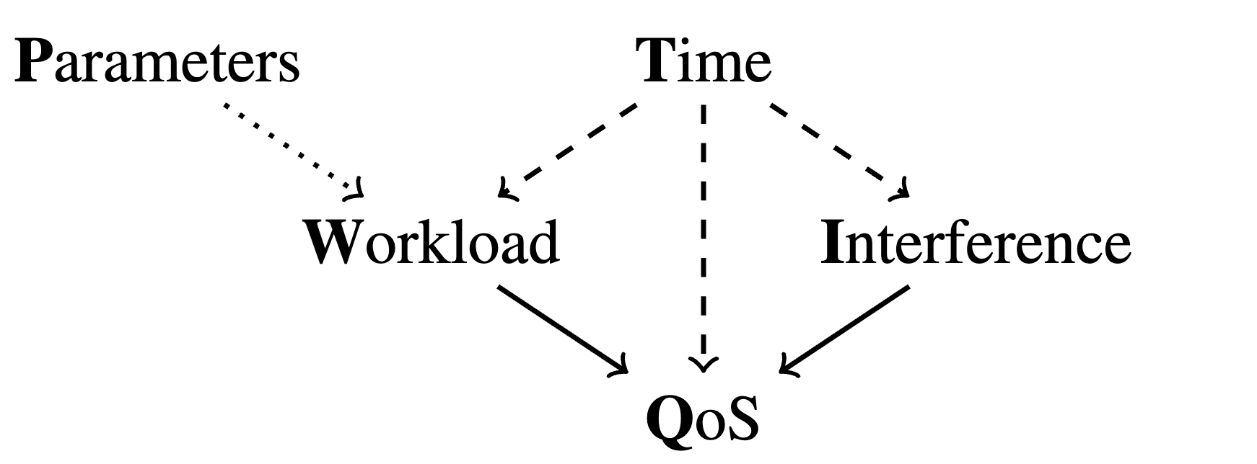
Propagating
Propagating
Workload Prediction
QoS’s
Transformer
QoS History
QoS Prediction
Interference Prediction
Parameter changes can indirectly affect multiple metrics, not just workload
PIPCell arranges multiple Transformers according to a dependency graph
Each Transformer predicts a metric cluster from its history and parent predictions
Design captures complex dependencies while avoiding spurious correlations
Example: interference is treated as independent from workload, enforced by the graph
Notes:
Now, beyond the direct effects captured by HC-PEP, parameter changes can also indirectly influence other performance metrics, not just workload.
To handle this, PIPCell organizes multiple Transformers into a graphical structure.
After HC-PEP refines the workload prediction, each remaining metric cluster is predicted by its own Transformer.
These Transformers take two inputs: the historical data of their own cluster, and the prediction from their parent cluster in the dependency graph — the most causally relevant upstream component.
This design lets parameter effects flow naturally across metrics, capturing complex dependencies in an interpretable way.
At the same time, the graph prevents the model from learning spurious correlations.\
For example, interference is correctly treated as independent from workload, a constraint explicitly built into the graph.

Slide 16

Content
Challenges
Approach
Background
Evaluation
Conclusion
Notes:
Next, I will introduce the evaluation results.

Slide 17
Experiment Setup
Research Questions (RQs)
RQ1: How does PIPCell perform compared to baselines?
RQ2: How much does each component contribute?
RQ3: How well does PIPCell generalize across regions?
Dataset
Real-world dataset from China Mobile (Aug 11–30, 2022)
1,045 parameter adjustment cases
628 samples per case, sampled every 15 minutes
17 monitoring metrics across 3 clusters
Notes:
We conduct our experiments using a real-world dataset collected by China Mobile, covering 1,045 parameter adjustment cases across different cells.
Each case contains around 600 data points sampled every 15 minutes, and we track 17 key performance metrics grouped into three clusters.
Our goal is to answer three main research questions.
First, how does PIPCell perform compared to existing methods?
Second, how much does each part of the framework actually contribute to its overall performance?
And finally, can the model generalize to new cells in other regions?

Slide 18
Experiment Setup
Baseline Methods
GBRT: Traditional machine learning model for time-series regression
VCNet: Deep neural model for causal effect estimation
β-Intact-VAE: Variational autoencoder capturing latent causal factors
Evaluation Metrics
RMSE — Root Mean Squared Error
sMAPE — Symmetric Mean Absolute Percentage Error
Train/Test Split: 50% / 50%, repeated 10 times
Prediction horizon: 1 day (96 time steps)
Notes:
For baselines, we use GBRT, a traditional gradient boosting model that provides a strong machine learning baseline.
Then we include VCNet, a neural model specifically designed for causal effect estimation.
Finally, beta-Intact-VAE, which uses a variational autoencoder to learn underlying causal structures in the data.
We evaluate performance using two standard metrics: RMSE and sMAPE.
Each experiment uses a 50-50 train-test split and is repeated ten times for robustness.
The prediction horizon is one day — meaning the model forecasts the next 96 time steps based on the previous day’s data.

Slide 19
RQ1: How Does PIPCell Perform Compared to Baselines?
Method | Relative RMSE |  | Relative sMAPE
 | mean(std) | p-value | mean(std) | p-value
GBRT | 1.347(0.80) | 0.007* | 2.440(2.69) | 0.000*
VCNet | 6.739(9.53) | 0.000* | 5.220(11.5) | 0.000*
β-Intact-VAE | 4.996(10.3) | 0.002* | 11.693(37.5) | 0.000*
PIPCell | 1.000(0.00) | / | 1.000(0.00) | /
*Statistically significant as p < 0.05
PIPCell outperforms all baselines with significant accuracy gains
and robust generalization across scenarios
Notes:
Next, we compare PIPCell with GBRT, VCNet, and β-Intact-VAE.
PIPCell achieves the best results, reducing RMSE and sMAPE by twenty-five point eight percent and fifty-nine percent.
Even though GBRT is a traditional model, it outperforms the two deep learning–based causal estimators.
PIPCell goes further, leveraging Graphcal Transformer and HC-PEP for accurate and interpretable predictions.
Statistical tests confirm these improvements are significant.

Slide 20
RQ2: How Much Does Each Component Contribute?
Variant | Relative RMSE |  | Relative sMAPE
 | mean(std) | p-value | mean(std) | p-value
PIPCell | 1.000(0.00) | / | 1.000(0.00) | 0.000*
A1 | 0.973(0.26) | 0.189* | 1.409(0.89) | 0.000*
A2 | 1.621(0.99) | 0.003* | 2.005(1.34) | 0.000*
B1 | 1.458(1.33) | 0.013* | 2.007(1.80) | 0.000*
B2 | 5.219(13.7) | 0.004* | 13.400(44.9) | 0.000*
B3 | 16.179(49.8) | 0.001* | 36.496(13.3) | 0.000*
*Statistically significant as p < 0.05
Model Variants:
HC-PEP Replacements: A1 – Multiplier | A2 – VCNet
Transformer Replacements: B1 – GBRT | B2 – NLinear | B3 – Autoformer
Notes:
We then investigate how each component contributes to PIPCell through ablation studies.
First, the HC-PEP multiplier is critical for adjusting Workload.
Replacing it with a simple data-driven Multiplier or VCNet leads to worse performance.
Using HC-PEP improves RMSE and sMAPE by thirty-eight percent and fifty percent, showing the value of incorporating domain knowledge.
Second, the Transformer predictor is essential for accurate forecasting.
Substituting it with GBRT, NLinear, or even Autoformer degrades performance, because cellular traffic is irregular and lacks strong periodic patterns.

Slide 21
RQ3: How Well Does PIPCell Generalize Across Regions?
Method | Relative RMSE |  | Relative sMAPE
 | mean(std) | p-value | mean(std) | p-value
GBRT | 1.665(0.76) | 0.001* | 3.294(7.88) | 0.002*
VCNet | 7.523(14.5) | 0.000* | 10.313(19.7) | 0.000*
β-Intact-VAE | 7.259(10.7) | 0.000* | 14.127(27.6) | 0.000*
PIPCell | 1.000(0.00) | / | 1.000(0.00) | /
*Statistically significant as p < 0.05
PIPCell maintains high accuracy and robust performance across different regions
Notes:
Finally, we test PIPCell’s ability to generalize to a different geographical region.
We collected 60 test cases from a region not included in the training data.
The results show that PIPCell consistently outperforms all baselines in both RMSE and sMAPE, proving its robustness across regions.

Slide 22
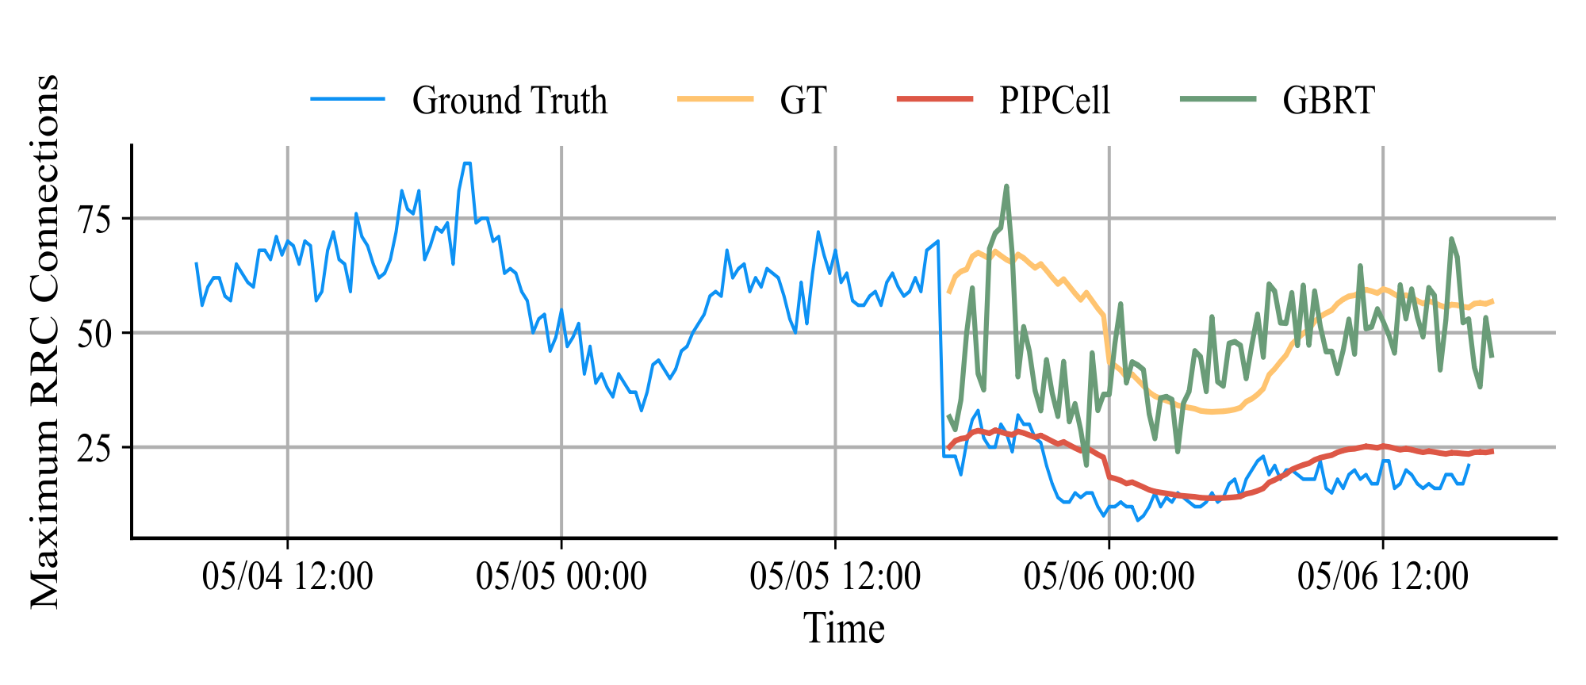
RQ3: How Well Does PIPCell Generalize Across Regions?
TP=18.2dBm TP=12.2dBm
TP reduced from 18.2 dBm to 12.2 dBm
Graphical Transformer fails to capture impact after TP drop
HC-PEP enables PIPCell to adapt dynamically and improve accuracy
PIPCell outperforms best baseline GBRT, capturing real effects of parameter changes
Notes:
Let me give you a concrete example. We look at predicting the maximum number of RRC connections.
When the transmission power dropped from eighteen point two dBm to twelve point two dBm,
a standard Graphical Transformer, trained only on adjustment-free data, failed to notice the change and consistently overestimated the metric.
In contrast, by using the HC-PEP multiplier for dynamic correction, PIPCell quickly adapts to the parameter adjustment and significantly improves prediction accuracy.
Compared with the strongest baseline, GBRT, PIPCell more faithfully follows the metric after the adjustment, capturing the real impact of the parameter change.

Slide 23

Content
Background
Challenges
Approach
Evaluation
Conclusion
Notes:
Let me now wrap up and summarize our work.

Slide 24
Conclusion
Predicting the Impact of Parameter Adjustments
on Cellular Networks
Core innovation
Design
Validated performance
Adjusting: HC-PEP refines workload by modeling TP
and CIO effects
Propagating: Graphical Transformers propagate
parameter impacts across
metrics
Presents PIPCell, a framework designed to predict how changes in cell parameters impact key performance metrics over time
Consistently outperforms baselines on real-world datasets from China Mobile , with experiments validating the effectiveness of each component
Notes:
In conclusion, PIPCell is a framework designed to predict how changes in cell parameters impact key performance metrics over time.
In the first phase, it produces adjustment-free forecasts for Workload and Interference, and then refines the Workload using HC-PEP, directly capturing the effects of transmission power and CIO changes.
In the second phase, Graphical Transformers propagate these parameter effects across metrics, modeling complex interdependencies in a controlled and interpretable way.
Our experiments show that PIPCell can reduce RMSE by up totwenty-five point eight percent compared to strong baselines, each component makes a meaningful contribution, and the framework generalizes well across different deployment regions.

Slide 25

This work was conducted at the AIOps Laboratory, School of Software, Nankai University (AIOps@NKU).
Lab website: https://nkcs.iops.ai/
Contact email: cuitianyu@mail.nankai.edu.cn
Please feel free to reach out with any questions or feedback!
Notes:
Our presentation has ended.
Thank you for your listening.

